Slide 1
OPTIMUM ENERGY MANAGEMENT SYSTEM
Presented by, Guided by,
Snehal Dalvelkar prof. Kirti Shinde
Harshali Bhamare prof.R.R. Khinde sir
Achala Bhardwaj

Slide 2
Introduction:
This Project “OPTIMUM ENERGY MANAGEMENT SYSTEM” using PIC Microcontroller is a reliable circuit that takes over the task of controlling the room loads as well as counting number of persons/ visitors in the room very accurately.
When somebody enters into the room then the counter is incremented by one and the light in the room will be switched ON.
when any one leaves the room then the counter is decremented by one.
The light will be only switched OFF until all the persons in the room go out. The total number of persons inside the room is also displayed on the lcd display.

Slide 3
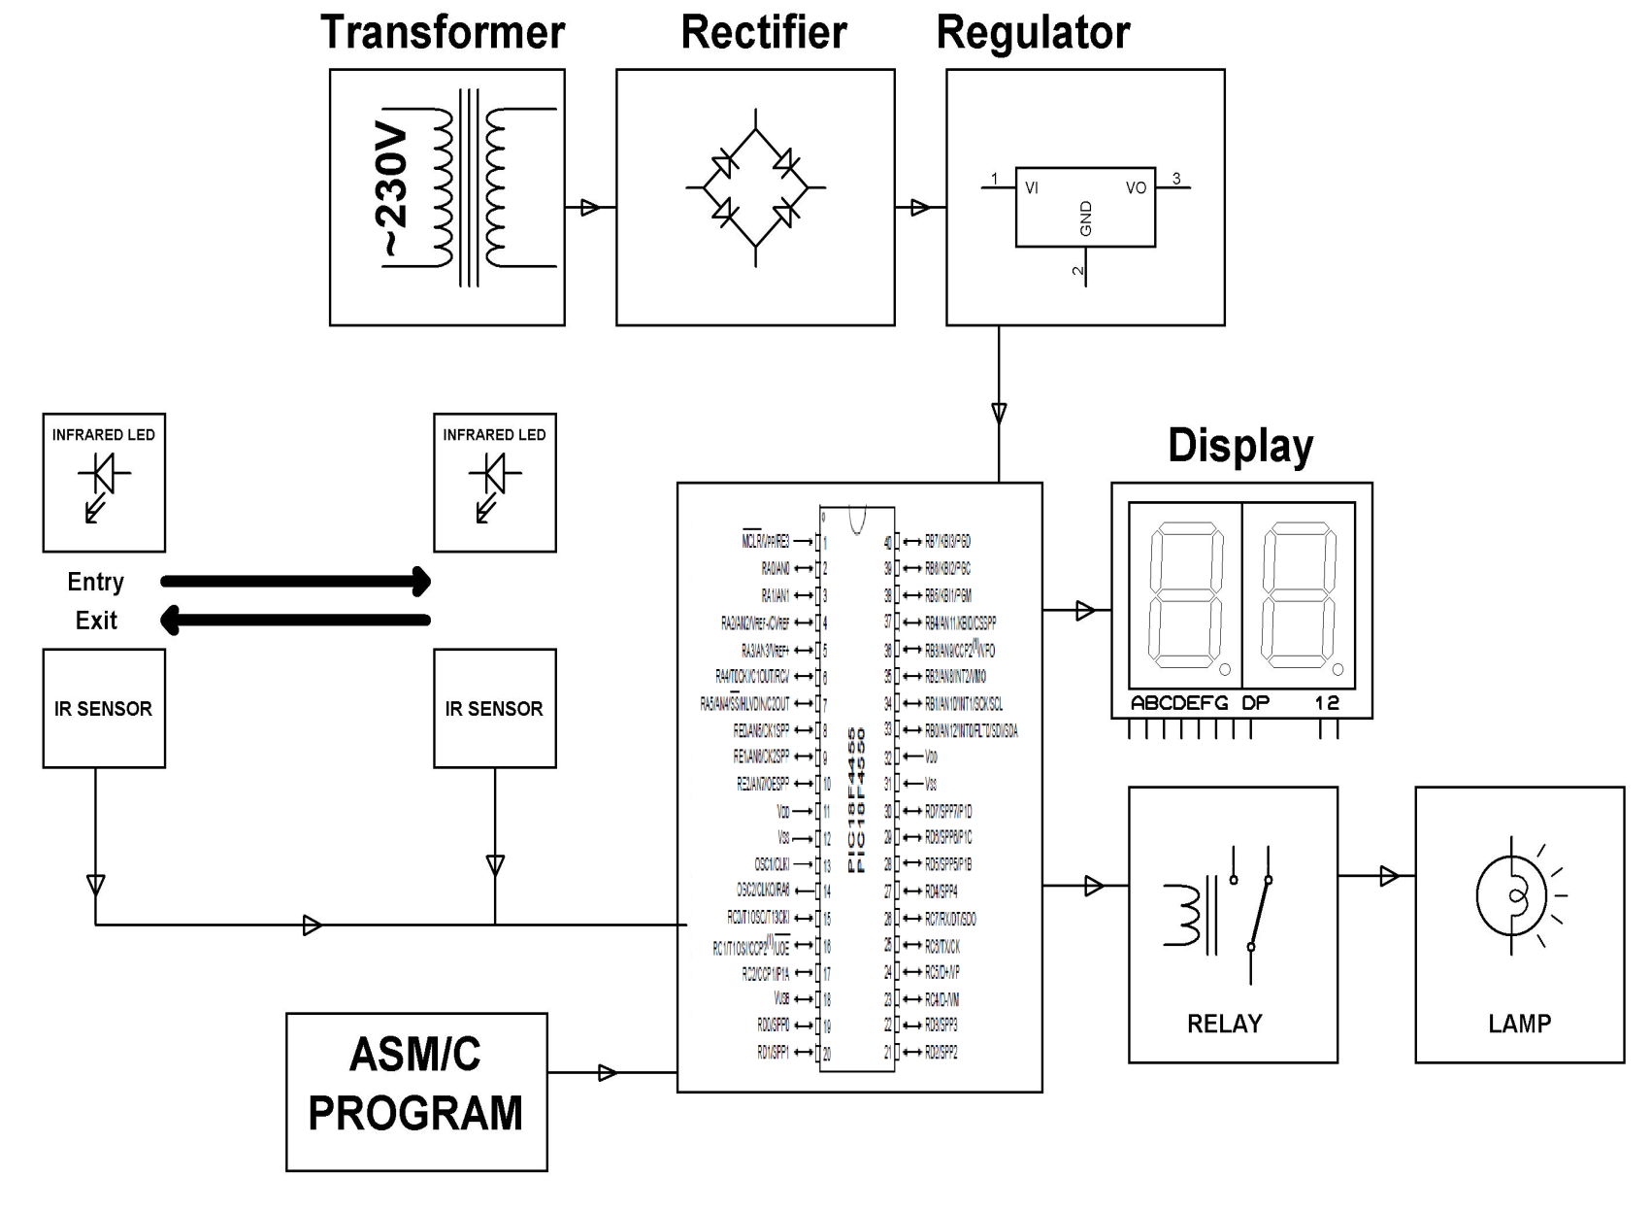
Block Diagram:

Slide 4
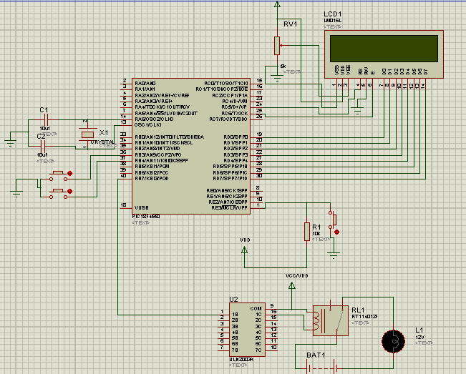
Circuit diagram:

Slide 5
Circuit Diagram Explanation:
There are two pair sensors, each kept at certain distance from the other. One pair of sensor consists of a transmitter and a receiver, kept exactly opposite to each other. The transmitting part emits modulated IR light which is received at the receiver end and fed to a microcontroller of pic18 family.
When a person enters the room then microcontroller senses it (with the help of IR sensors) and increments the count and displays it on LCD display and also switches ON the load. In the same way when a person exits the room, the count gets decremented. When the last person exits from the room, the lamp is switched OFF. The load operation is handled by a relay interfaced to the microcontroller.

Slide 6
Hardware Requirements:
POWER SUPPLY
PIC MICROCONTROLLER (PIC18F4550)
IR LED MODULE
RELAY
LAMP
ULN2003 IC
LCD DISPLAY

Slide 7
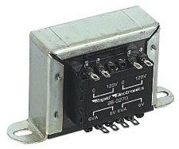
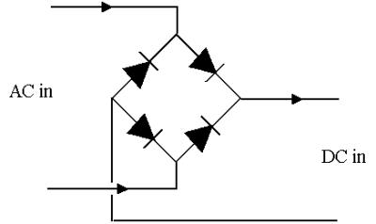
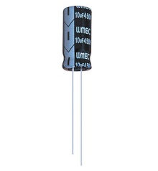
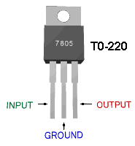
Power Supply:
230 V AC
50 Hz
Bridge rectifier
5v Regulator
5V DC
Filter(470µf)
12V step down
transformer

Slide 8
Specifications of pic18f4550
Program Memory (KB) - 14
CPU Speed (MIPS) - 5
RAM Byte - 368
Data EEPROM (bytes) -256
Digital Communication Peripherals 1-UART, 1-SPI, 1-I2C1-MSSP(SPI/I2C)
Capture/Compare/PWM Peripheral - 22 CCP
Timers - 2 x 8-bit, 1 x 16-bit
ADC - 8 channel, 10-bit
Comparator – 2
Operating Voltage Range (V) - 2 to 5.5
Pin Count - 40

Slide 9
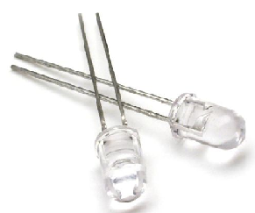
IR LED:
An IR LED, also known as IR transmitter, is a special purpose LED that transmits infrared rays in the range of 760 nm wavelength.
Such LEDs are usually made of gallium arsenide or aluminum gallium arsenide. They, along with IR receivers, are commonly used as sensors.
The appearance is same as a common LED. Since the human eye cannot see the infrared radiations, it is not possible for a person to identify whether the IR LED is working or not, unlike a common LED.

Slide 10
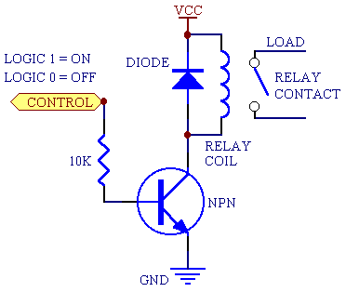
Relay:
It is a electro magnetic switch
Used to control the electrical devices
Copper core magnetic flux plays main role here

Slide 11
FLOWCHART
Start
Infrared Signal Transmission
Turn On Relay
Interrupted from Sensor1
Interrupted from Sensor 2
Turn On Light
Counter Increment
Counter Decrement
Counter set to 0
Relay Turn Off
Turn Off Light

Slide 12
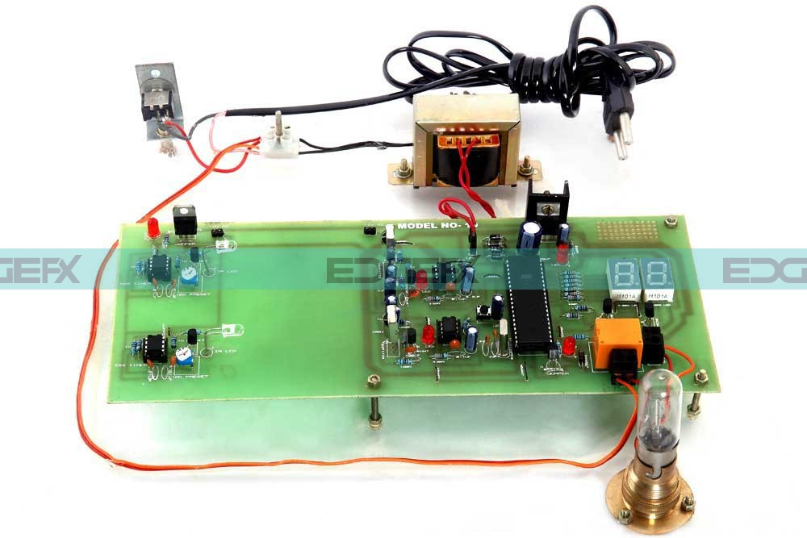

Slide 13
Advantages:
Managing and reducing energy consumption and saves money
Energy management is widely acknowledged as the best solution for direct and immediate reduction of energy consumption.
Disadvantages:
It is used only when one single person cuts the rays of the sensor hence it cannot be used when two person cross simultaneously.

Slide 14
Application
For counting purposes.
For automatic room light /fan control.

Slide 15
FUTURE EXPANSION
By using this circuit and proper power supply we can implement various applications
Such as fans, tube lights, etc.
By modifying this circuit and using two relays we can achieve a task of opening and closing the door.

Slide 16
Conclusion:
Optimum Energy Management System is designed to monitor the number of persons entering as well as exiting a room. Electrical loads are switched ON as the first person enters and switches OFF when the last person leaves. IR sensors used in combination with microcontroller to monitor all the operations. This helps in saving lot of energy.

Slide 17


